Slide 1
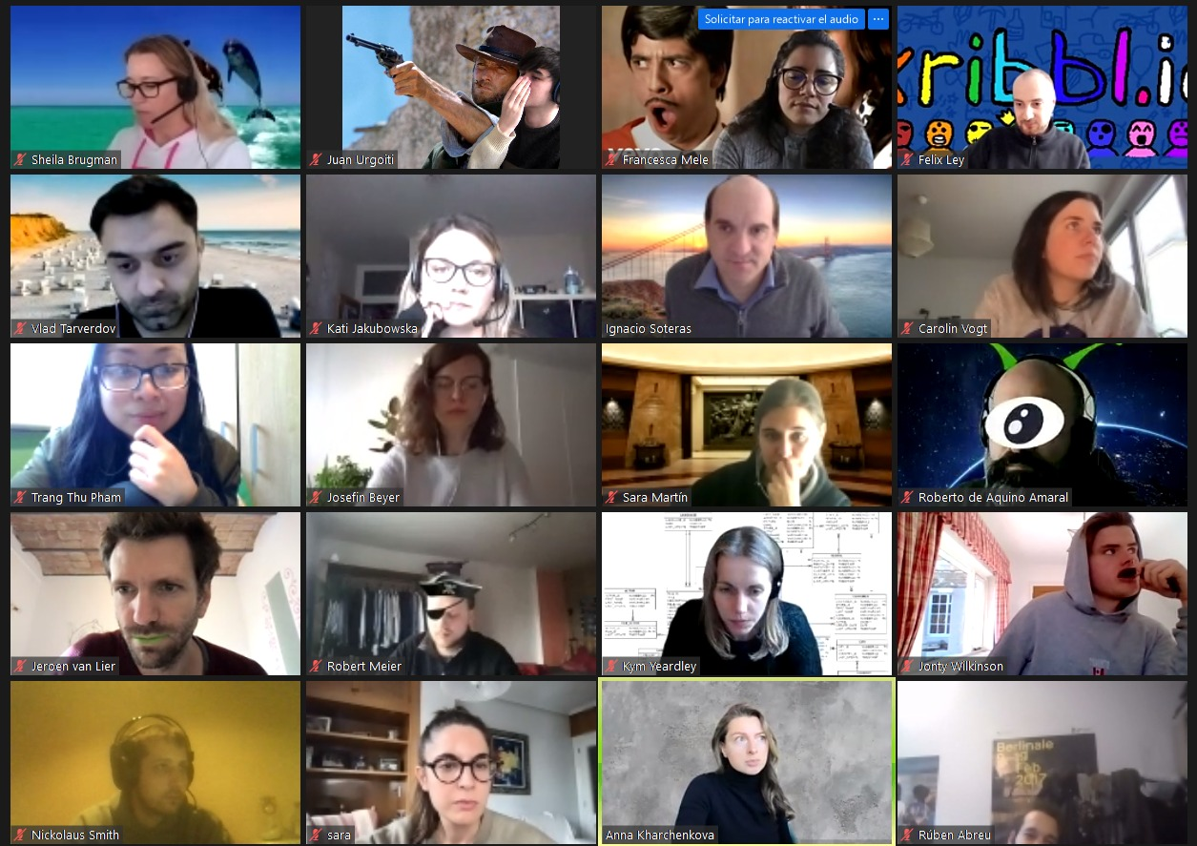
FINAL PROJECT
DATA ANALYTICS JAN-MARCH 2021 | IRONHACK
Income Classification

Slide 2



IRONHACK BOOTCAMP
Agenda
Topic introduction
Different approaches in building the model
Key Findings
Future Improvement possibilities
Credit: kontist.com

Slide 3
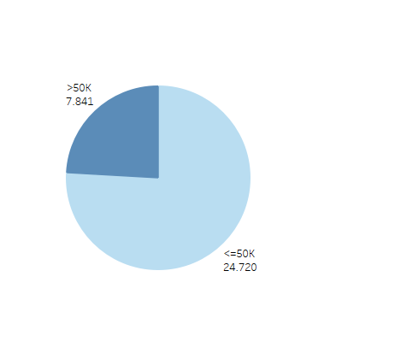
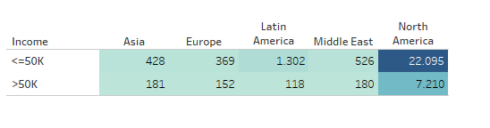
Income Data Set
Short summary
Data set of 32561 rows and 15 columns
38 countries (most records from
North America)
3. Imbalanced data ( 76% <= 50k, 24% >50k),

Slide 4
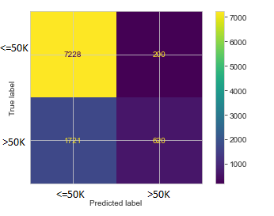
Building the model
Raw Data | Logistic Regression
Accuracy | 0,80
Kappa | 0,31

Slide 5

IRONHACK BOOTCAMP
Cleaning the data
Trying out different transformations
Grouping different columns
Over-sampling
Under-sampling
Comparing different models
Credit: kontist.com

Slide 6
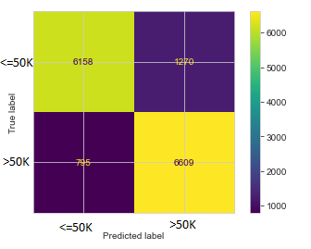
The best model
Best Model (attempt 9) | Logistic Regression
Accuracy | 0,86 ( + 0.06 )
Kappa | 0,72 ( + 0.41 )

Slide 7
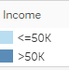
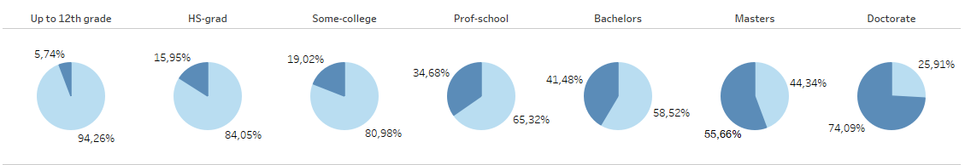
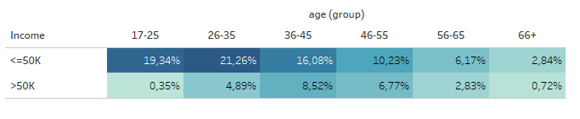
Key findings

Slide 8
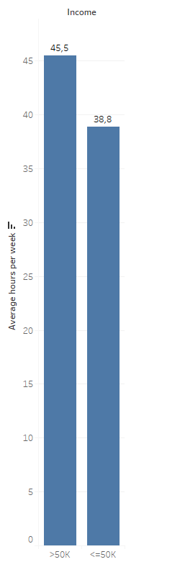
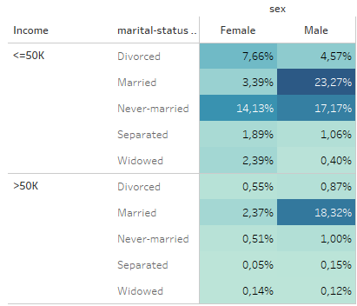
Key findings

Slide 9

IRONHACK BOOTCAMP
Gathering more balanced data
Cleaner features
More diverse features
Bigger samples
Credit: kontist.com

